Slide 1
Kenya Food Price Early Warning System
A Data Science Capstone Project
Forecasting staple food prices across Kenyan markets to give farmers, traders, and food security actors an early signal
Presented by [Presenter Name]
Data: WFP Kenya Food Prices (HDX) • NASA POWER Weather API

Slide 2
Agenda — CRISP-DM Structure
1. Business Understanding
2. Data Understanding
3. Data Preparation
4. Modelling
5. Evaluation
6. Key Insights
7. Recommendations
8. Limitations
9. Conclusion & Next Steps

Slide 3
The Problem
Farmers decide when to sell without knowing which way prices are heading
Traders and institutions often react to shortages only once they are visible
Kenya has rich historical price data, but it explains the past, not the future

Slide 4
Why It Matters
This project turns historical prices + weather data into a forward-looking signal
Goal: show where prices are likely to move, and flag unusual changes early
This refines how the goal is achieved — the original mission (early visibility into food price changes) is unchanged

Slide 5
Who This System Serves
Smallholder farmers & cooperatives — decide when and how much to sell
Traders & intermediaries — manage inventory and buy/sell timing
County offices & NDMA — early signals of localized food stress
NGOs & humanitarian organizations — plan procurement and cash interventions
National Cereals & Produce Board — strategic reserve and release decisions
Urban & low-income households — anticipate rising staple food costs
Food processors & millers — predictable input costs for planning

Slide 6
Business Objectives
Forecast commodity prices 2–3 months ahead for individual markets
Detect emerging price shocks as they begin to unfold
Present forecasts through a simple, non-technical dashboard
Support institutional decisions on reserves, subsidies, and response
Build a reproducible, automated pipeline end to end

Slide 7
Business Success Criteria
Forecasts beat a simple baseline (last price / seasonal average)
Anomaly detection catches real shocks without excessive false alarms
A non-technical user can read expected price & alert status at a glance
The pipeline is reproducible and refreshable with minimal manual work

Slide 8
Hypotheses Guiding the Analysis
H1 — Maize prices follow a seasonal pattern around harvest periods
H2 — Rainfall has a measurable lagged relationship with future prices
H3 — Price patterns differ significantly between markets
H4 — Maize and bean prices are related as staple substitutes
H5 — Price volatility increases during drought periods
H6 — Wholesale price changes reach retail within 1–2 weeks
These are revisited honestly — supported, rejected, or untested — in Key Insights

Slide 9
The Data
WFP Kenya Food Prices (HDX):
27,763 price observations
226 markets • 51 commodities
Date range: January 2006 – August 2026
NASA POWER Weather API:
Daily rainfall and temperature by market coordinates
Used to test whether weather can improve price forecasts

Slide 10
Key Fields in the Price Dataset
Column | Description | Example
date | Date of the price observation | 2006-01-15
market / market_id | Local market name and unique ID | Mombasa, 191
latitude / longitude | Market site coordinates | -4.05, 39.67
commodity / category | Specific food item and broad group | Maize (white), cereals & tubers
unit | Unit of measurement for the price record | KG, 90 KG
pricetype | Level of trade transaction | Wholesale, Retail
price / usdprice | Price in KES and USD equivalent | 1,480.00 / 20.58
Notes:
Full schema also includes admin1/admin2 region, commodity_id, priceflag, currency. Weather variables (NASA POWER): T2M, T2M_MAX/MIN, RH2M, PRECTOTCORR.

Slide 11
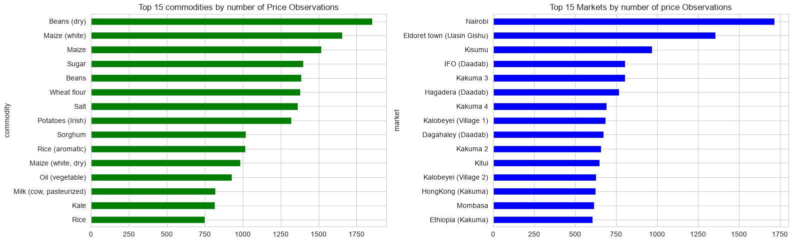
Coverage: Top Commodities & Markets by Observations
Maize and beans lead commodity coverage; Nairobi and a handful of major markets carry the largest number of price observations.

Slide 12
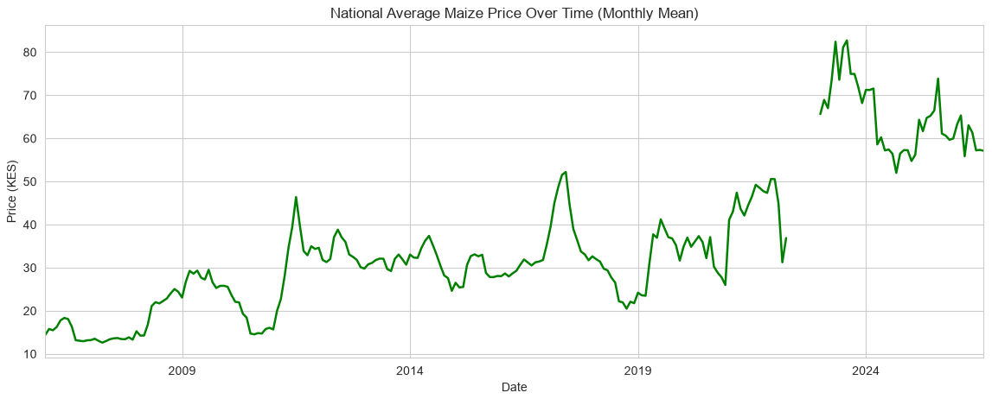
National Average Maize Price Over Time
Long-term upward trend with repeated volatility spikes, rather than a stable plateau.

Slide 13
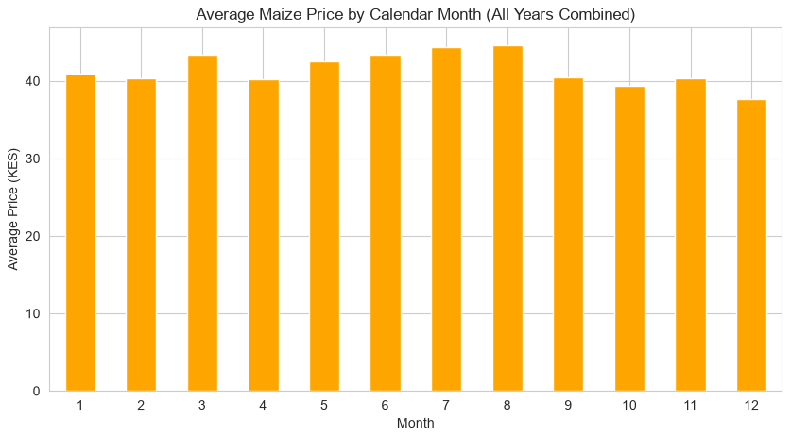
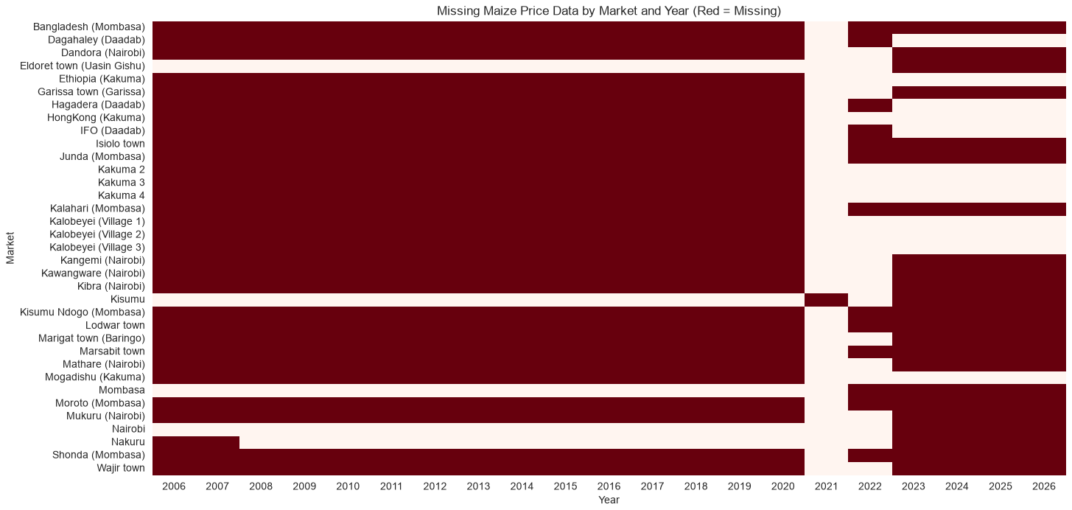
Seasonality and Data Coverage
Left: mild recurring seasonal shape across the year (early support for H1). Right: data coverage by market and year — red indicates missing data.

Slide 14
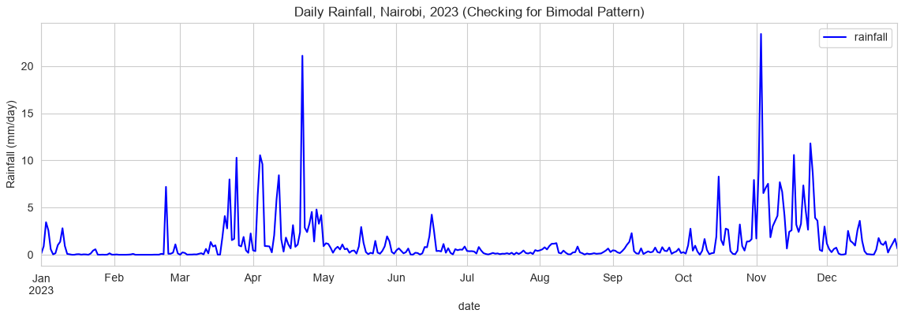
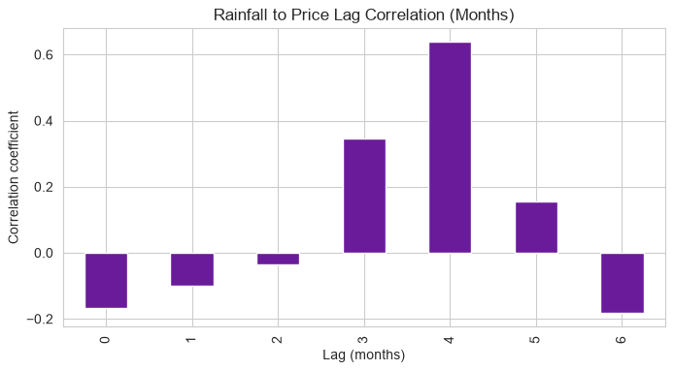
Weather as a Candidate Signal
Kenya's bimodal rainfall pattern is visible and credible. The lag correlation shown here used only one year of Nairobi data — flagged as preliminary and re-tested at full scale in Data Preparation.

Slide 15
Data Quality Summary
Commodity labels: maize appears under different labels — to be consolidated
Duplicates: none found at market, commodity, date, and price-type level
Outliers: a small number of maize price points flagged via IQR — reviewed, not auto-removed
Market coordinates: one market missing lat/long — excluded from the weather join
Date coverage: spans January 2006 to August 2026

Slide 16
Cleaning & Scoping Decisions
Retail prices selected as the primary modelling target
Closest price level to what households and small traders experience
Wholesale prices reserved for a future extension
Items excluded, with reasons:
Fuel (diesel/petrol) — different market dynamics from food commodities
Milk, oil, bananas — priced by volume/count, not comparable per kg

Slide 17
Building the Shortlist
2,021 candidate market–commodity pairs screened for completeness & history
133 pairs passed completeness and history-length filters
Split into two modelling tracks:
100 long-history pairs → Prophet track
33 recent-only pairs → LSTM track
Final shortlist: 133 pairs across 26 markets and 14 commodities

Slide 18
Handling Outliers
Flagged price points were classified, not deleted:
45 — Persistent shift: a genuine, lasting change in price level — retained as-is
22 — Transient spike: a short-lived jump consistent with a real shock — retained, later used to build the anomaly detector
2 — Insufficient data to classify confidently — handled with caution

Slide 19
Weather Integration & the Real Lag Test
Weather retrieved per market from NASA POWER, aggregated monthly, joined by market and date
Preliminary read (Data Understanding): ≈0.64 correlation at a 4-month lag
Based on one year of Nairobi rainfall vs. the full national price series — not a fair test
Full-scale test (proper, on the master table): ≈ -0.02 correlation at a 4-month lag
Temperature also showed only a weak relationship (≈0.11)
This is a key example of a preliminary finding being corrected once tested properly

Slide 20
Master Table & Train/Validation/Test Split
Master analytical table: 6,077 rows
Weather match rate: 98.98%
Feature engineering added lagged prices, rolling statistics, calendar features, and market/commodity identifiers
Chronological split (not random) to avoid training on future data:
Train: 4,807 rows
Validation: 622 rows
Test: 648 rows

Slide 21
Modelling Approach
Target: price per kg, one month ahead
Naive Baseline — assumes next month's price equals this month's price
Prophet — a seasonal time-series model, fit independently per pair
LSTM (Neural Network) — a sequential deep-learning model, tested both per-pair and pooled with entity embeddings
All models compared against the same chronological validation and test sets

Slide 22
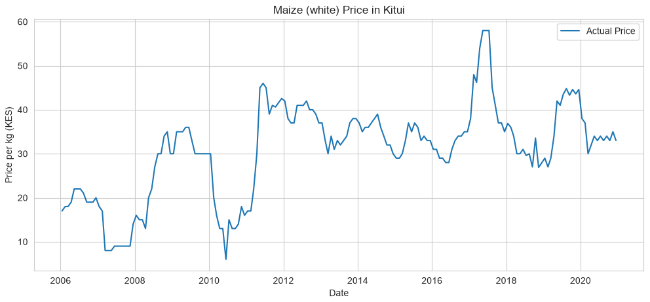
Pilot Series: Maize (White) in Kitui
180 monthly observations, used to build and sanity-check the full modelling pipeline before scaling to all 133 pairs.

Slide 23
Single-Series Results (Kitui Maize)
Naive Baseline: MAE 8.54
Prophet: MAE 7.00 (MAPE 19.7%)
LSTM: MAE 2.41 (MAPE 7.1%)
On this one series, LSTM clearly outperforms both Prophet and the naive baseline

Slide 24
At Scale: Pooled Entity-Embedding LSTM
Tested across all 132 LSTM-track pairs, not just the Kitui pilot series:
Per-pair LSTM (132 separate models): MAE 16.99
Pooled model, no identity (ablation): MAE 8.81
Pooled model + entity embedding: MAE 6.49
More than 50% error reduction from pooling + entity embeddings vs. per-pair models
The ablation confirms the gain comes from learning market/commodity identity, not just from pooling data

Slide 25
Model Selection at Scale
A validation-weighted router blends each model with naive per pair
Of 132 pairs:
106 — pure naive (no model added value)
26 — partial blend with a model
0 — fully model-leaning
83.3% of pairs finish at or better than naive — but largely due to ties with naive, not clear model wins

Slide 26
Does Any Model Reliably Beat Naive?
Prophet — did not consistently beat naive once tested across the full pair set
Per-pair LSTM — best on the Kitui pilot series, far weaker on average across all 132 pairs (MAE 16.99)
Pooled LSTM — the strongest model overall (MAE 6.49), but still not a reliable, consistent win over naive at the individual-pair level
Conclusion: no model reliably beats naive per pair — persistence is itself a real, well-supported finding

Slide 27
The Anomaly Detector Works
Method: flag a price as anomalous when it deviates more than 2 standard deviations from a naive expanding-window expectation
Baseline flag rate (all months): 9.7%
Flag rate during documented shocks: 27.6% (~2.8x higher)
Validated against three real events: 2021–22 East Africa drought, 2022 Ukraine grain-market shock, 2022–23 Kenyan fuel subsidy removal

Slide 28
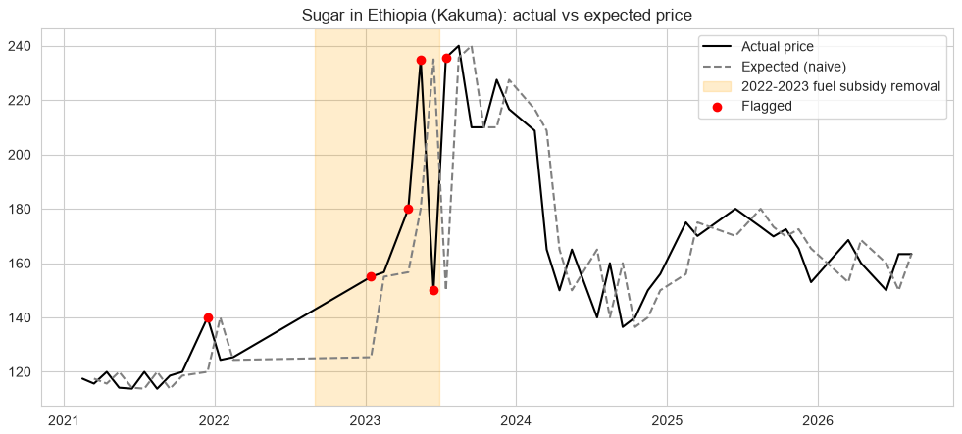
Anomaly Detection in Action: Sugar, Ethiopia (Kakuma)
Red points mark months flagged as anomalous during the 2022–23 fuel subsidy removal — the detector reacts within the shock window, not months after it.

Slide 29
Key Insights
Pooling + identity halves error — a single model that learns market/commodity identity outperforms hundreds of separate small models (MAE 6.49 vs 16.99)
No model reliably beats naive per pair — persistence remains a strong, hard-to-beat benchmark
The anomaly detector shows real signal — flags shock periods at nearly 3x the baseline rate
Scope decisions were principled — every exclusion (fuel, volume-priced items, sparse markets) was made on stated, defensible grounds

Slide 30
Hypotheses Revisited, Honestly
Hypothesis | Status | Note
H1 — Seasonal maize pattern | Mild support | Modest peak mid-year, not a strong seasonal swing
H2 — Rainfall lag relationship | Rejected at scale | Preliminary 0.64 correlation did not hold at full scale (≈ -0.02)
H3 — Market-level price differences | Untested | Not formally tested in this phase
H4 — Maize/bean substitution | Untested | Flagged for future analysis
H5 — Drought-driven volatility | Inconclusive | Related to anomaly findings, not directly isolated
H6 — Wholesale-to-retail lag | Untested | Requires wholesale series, out of current scope

Slide 31
Recommendations
Deploy the anomaly detector first — the most validated, near-term-ready product
Prioritize humanitarian & refugee-camp markets — best documented shock coverage, most acute stakeholder need
Frame forecasts as persistence-aware — present alongside the naive baseline so users understand when a forecast adds real information
Extend to wholesale prices next — would allow testing the retail-lag hypothesis (H6) and support NCPB/bulk-buyer decisions

Slide 32
Limitations
Data:
Most markets have short or sparse price histories
Shock validation is biased toward refugee-camp markets
Weather-price relationship is weaker than hoped
Modelling:
No model reliably beats naive at the individual-pair level
Pooled model gains are strong on average but uneven per pair
Retail-only scope excludes wholesale dynamics (H6)
Deployment:
No live dashboard or pipeline built yet
Not yet tested with real end users

Slide 33
Conclusion: What Was Achieved
A cleaned, joined price + weather master table across 133 pairs
A pooled entity-embedding LSTM that halves error vs. per-pair models
An anomaly detector validated against 3 real documented shocks
An honest, evidence-based account of what does and doesn't work

Slide 34
Next Steps
Build the reproducible end-to-end data pipeline
Ship a simple dashboard surfacing forecasts and alerts
Field-test anomaly thresholds with real stakeholder users
Extend to wholesale prices and revisit untested hypotheses

Slide 35
Thank You
Questions & Discussion
Kenya Food Price Early Warning System — [Presenter Name] — [Contact / Email]

